Slide 1
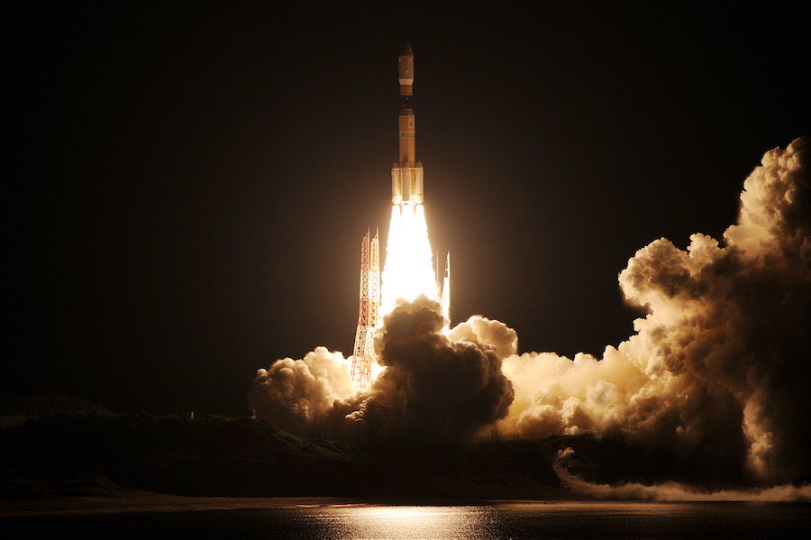
Project II: Space Launch Analysis
By: Team Rocket
Kelly Cash
Betsy James
Joe Kim
Sophie Qiao
Grace Sun

Slide 2
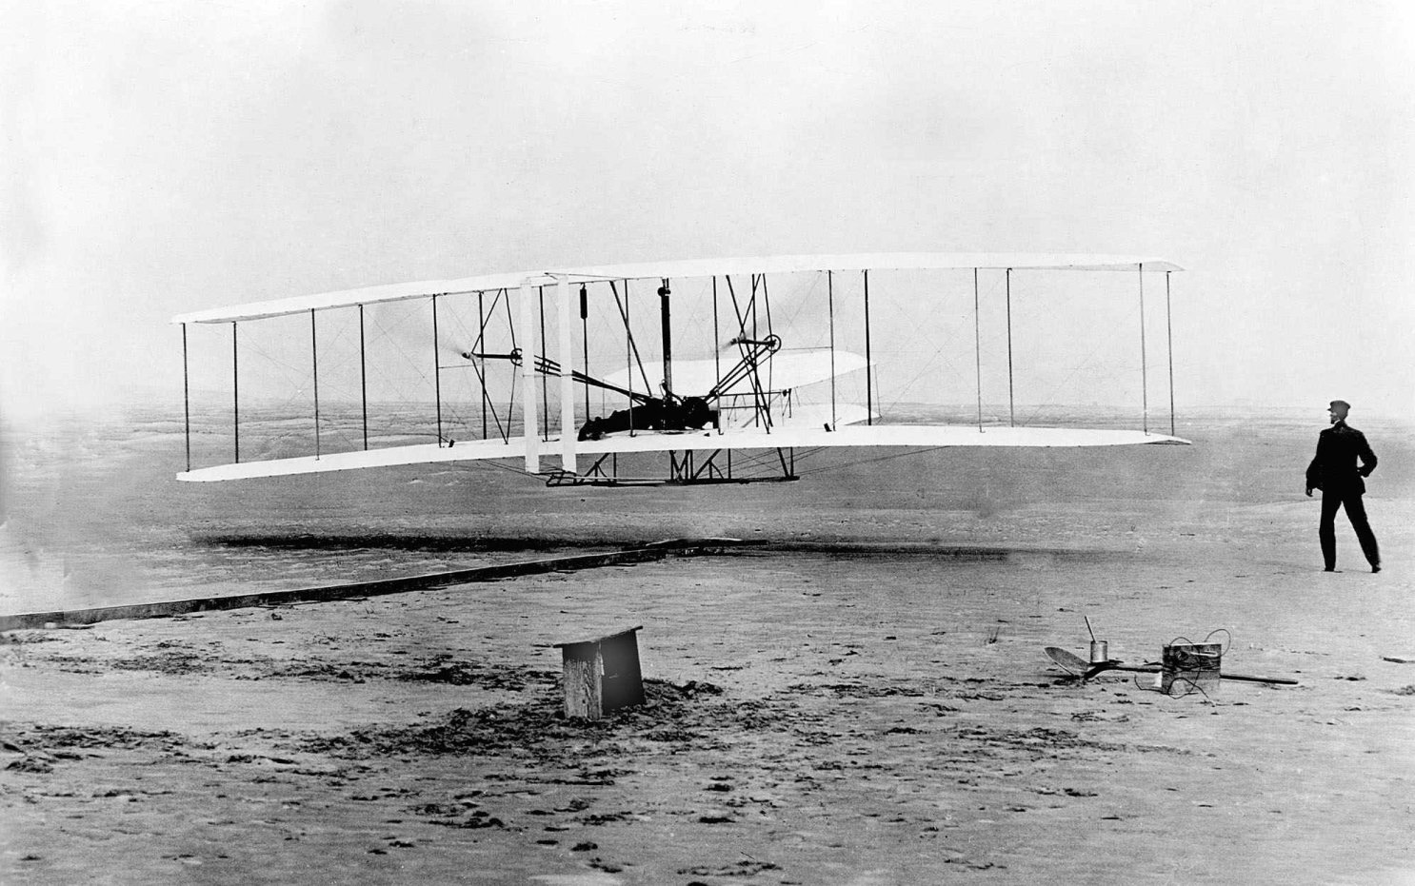
Quiz Time
What year did the Wright brothers invent the first successful airplane?
What year was the first rocket launch?
Answer: 1903
Answer: 1942

Slide 3
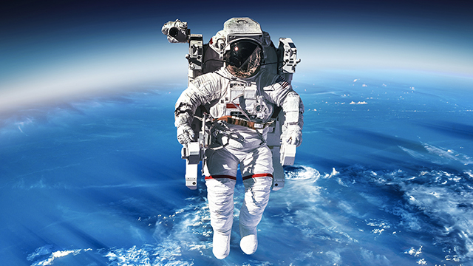
we are exploreRs!
Where are we from?
History of our universe and our solar system.
Save our lives from asteroids and comets.
Backup of humanity
Space mining
Many great inventions people use every day are due to space program research (insulin pumps, LASIK, memory foam, even DustBusters!)
1969: First human step on MOON
1976: First lander on MARS

Slide 4
What questions can be answered?
Where are the launching sites located across the world?
What country or countries were the leaders in the space race in the early decades? What about recent years?
What are the launch trends regarding state funding vs private funding across the years?
Are there “Elon Musks” from other countries who are doing private space launches?

Slide 5
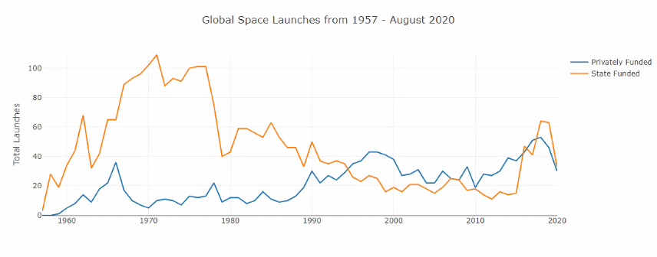
Space Act 2015
Cold War ended in 1991
Congress allows a “Finders, Keepers” rule
Gives American companies all rights to the bounty they extracted from celestial bodies.
State ran launches decrease
Privatization increased

Slide 6


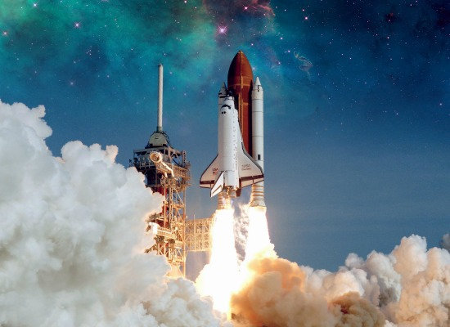
Conclusions
Overall trend: state funded launches occurred more often until 1994, when privately funded launches took over in numbers
Early space race winners: Russia and the USA, with not many other countries as competitors
Recent space race winners: the USA, Russa, and China, with many other countries also entering the race in more recent years

Slide 7







If we had more time
Web scraping to include data through April 2021
Closer examination of cooperative efforts between countries & who is getting involved in recent years
Deeper dive into leading privately funded launch companies:
What company or companies are currently winning the race?
What purpose do the launches serve?
Communications
Planetary Exploration

Slide 8


Slide 9
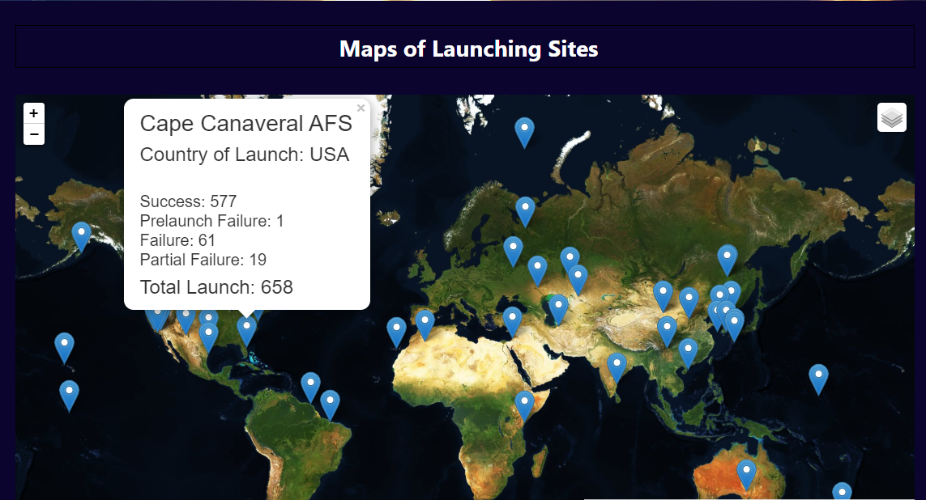

Slide 10
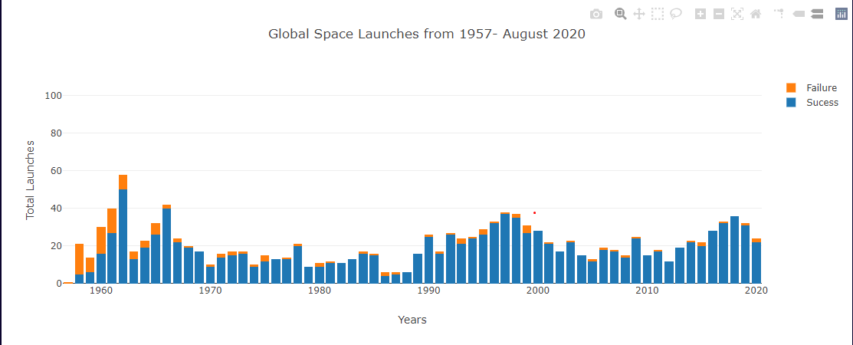

Slide 11
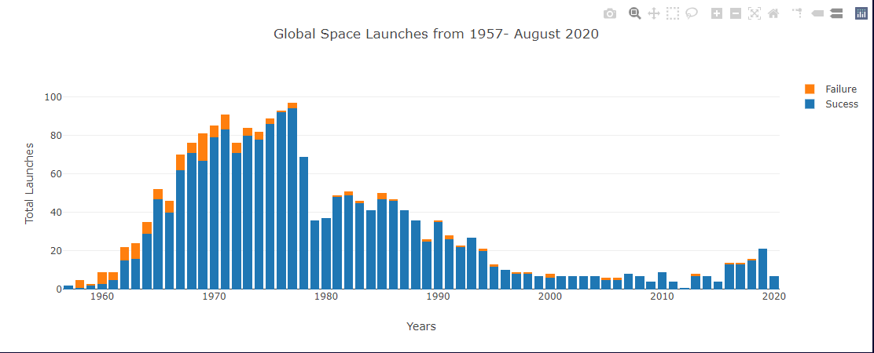

Slide 12
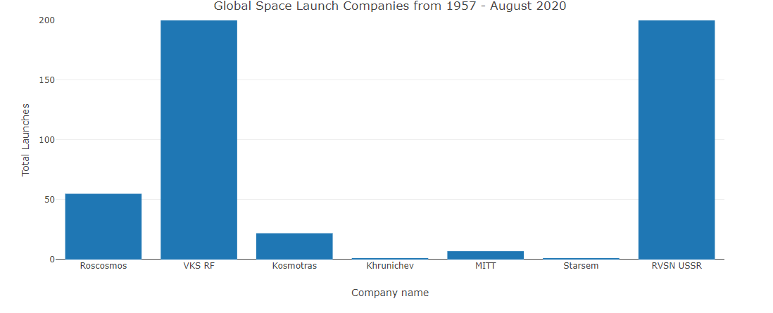

Slide 13
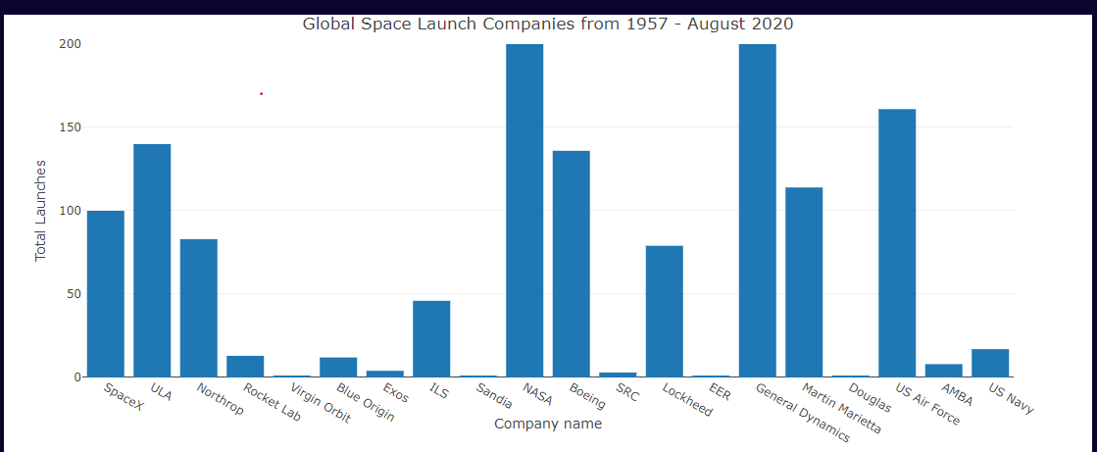

Slide 15
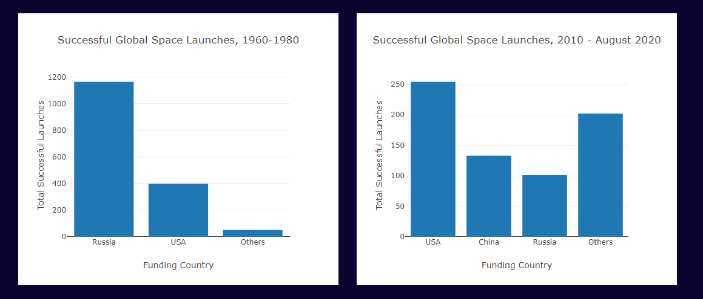

Slide 16
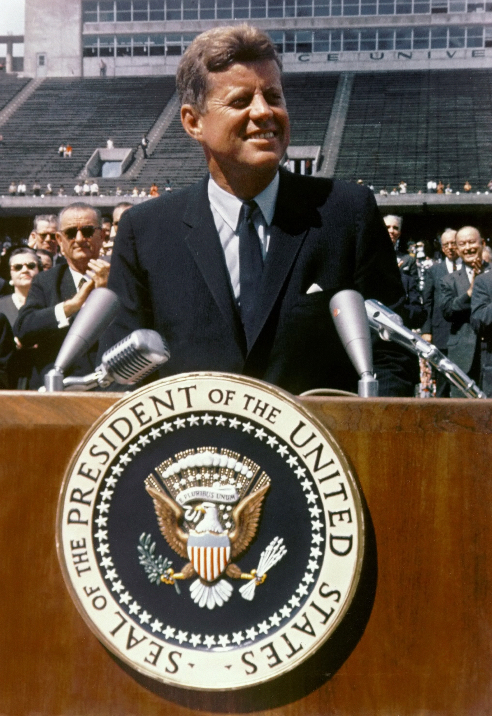
Moon Speech, Sept. 12, 1962
“The exploration of space will go ahead, whether we join in it or not, and it is one of the great adventures of all time, and no nation which expects to be the leader of other nations can expect to stay behind in the race for space.” John F. Kennedy

Slide 17
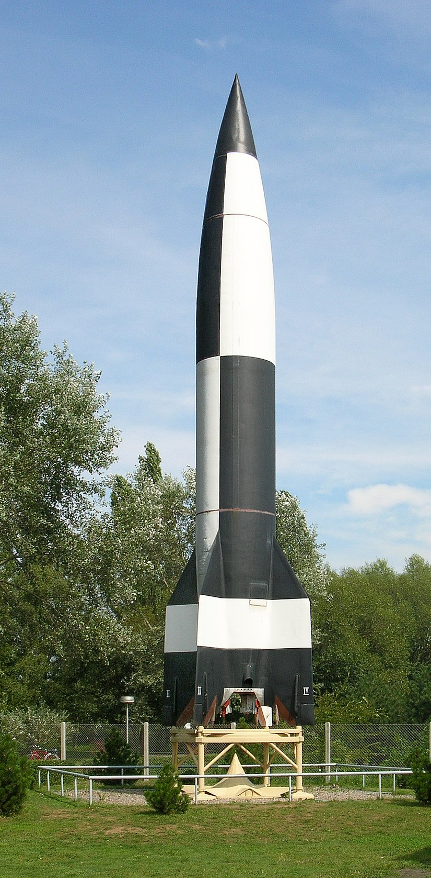




What was the driving force behind the Space Race?
National Security
Nationalism
Innovation
The 1st rocket was the V2 rocket that was shot off in Germany in 1942.
The 1st ICBM rocket was launched on Aug. 21 1957 by the USSR.
The 1st ICBM rocket launched by the US was on Dec. 17, 1957.

